Slide 1
Cooperative UAS Emitter Localization: Preliminary Research Results and Proposal Christopher Peters Spring 2024
Notes:
You will have 18 minutes for your talk, followed by 5 minutes for Q&A. Please design your charts to fit the time frame and practice to make sure you will not run out of time.
Most authors find that 10-12 charts are about right, as long as the charts are not overly complex or crowded. A structure that works for most talks is Problem Introduction, Your Solution, Advantages, and Disadvantages, Suggested Applications, Recommendations, Summary.
You can find the exact time and room for your presentation by logging in and viewing the Conference Schedule under the "resources" drop-down. Use the browser search to find your name or paper number. Check frequently for late changes in the exact time, but be assured you will not be moved from the stated day without us checking directly with you. The schedule will be on the home page once it is finalized.
If you have special points you would like your Session Organizer to include in your introduction, please send them beforehand. You can find SO email addresses on the conference website homepage under the PROGRAM tab under "Tracks and Sessions."

Slide 2
AGENDA
Introduction
Timing-based Localization Algorithms
Localization Error Sources & Models
Simulation Results
Proposal for Future Research
Notes:
Problem Introduction, Your Solution, Advantages, and Disadvantages, Suggested Applications, Recommendations, Summary.

Slide 3

ABOUT ME
Academic History:
M.S., Systems Engineering, Johns Hopkins University, 2019
Capstone Project: Bistatic Indoor Navigation System
M.S., Physics, University of Mississippi, 2009
Master’s Thesis: Motion Analysis of an Oscillating Target Using Laser Speckles
B.S., Physics, University of Mississippi, 2007
Undergraduate Thesis: Waste Heat Electrical Power Generation Using a Low Temperature Difference Stirling Engine
B.S., Mathematics, University of Mississippi, 2007
Professional History
2007-2022: Electrical Engineer & Systems Engineer – Raytheon Technologies (Forest, MS & McKinney, TX)
2022-2023: Electrical Engineer – L3Harris Technologies (Palm Bay, FL)
2023-Present: Lead Systems Engineer – Azure Summit Technologies
Primary Areas of Expertise & Responsibility:
Active Electronically Scanned Array (AESA) Antenna Engineering
System Integration, Test, and Analysis
Embedded Cybersecurity Development
Personal Life
Resides in Melbourne, FL
Loves: family, BBQ, long distance running, the beach

Slide 4






INTRODUCTION
Idea:
Utilize a network of Unmanned Aerial Systems (UAS) to locate RF emitters with minimal measurements & computations
Barriers:
UAS is bounded by hardware limitations: positioning error, local timing source synchronization errors ^{A}
In Urban environments, received signal is subject to Multipath and Atmospheric impacts causing localization errors ^{A,B}
Approach:
Exploit cooperative and mobility aspects of system as well as recent hardware advances to minimize localization errors
Accomplishments:
Comparison of localization algorithms ^{A}
Simulations of impacts of error sources to contrived system ^{A,B}
Identified hypothesis for minimal measurements to achieve time-efficient localization
C. Peters and M. A. Thornton, Cooperative UAS geolocation of emitters with multi-sensor-bounded timing and localization error, in 2023 IEEE Aerospace Conference, 2023, pp. 1-13.
C. Peters and M. A. Thornton, Evaluation of environmental and accumulated errors in localization with cooperative UAS arrays, in 2024 IEEE Wireless and Microwave Technology Conference, 2024, article submitted for publication.
Notes:
Emergency transponder beacon
GPS constraints
MINIMAL MEASUREMENTS & COMPUTATIONS
Time-based because phase coherence is challenging among array receivers
Pros: Small UASs allows for more challenging/dynamic mission environments that large aircraft cannot penetrate
Cons: carrying capacity (power, payloads); coupling the RF apertures

Slide 5
System Assumptions
“Cooperative” UAS System
UAS array operates as a collective unit
Signal measurements & individual locations are shared via wireless network
Cooperative UAS System model assumptions:
5 GHz signal
Omnidirectional sensor antennas
Fixed (and known) locations during measurement epochs
Sufficient SNR & bandwidth in 500m “cube”
Synchronized clocks
Emitter assumptions:
5 GHz signal
Omnidirectional antenna
Fixed location
Notes:
5 Sensors in this diagram; Reference Sensor = UAS 1
Texas Instruments has LIDAR with 1cm at 100m
CSAC options such as Orolio: low drift and jitter; free-running source synced at pre-mission time

Slide 6
Localization Approach

Slide 7
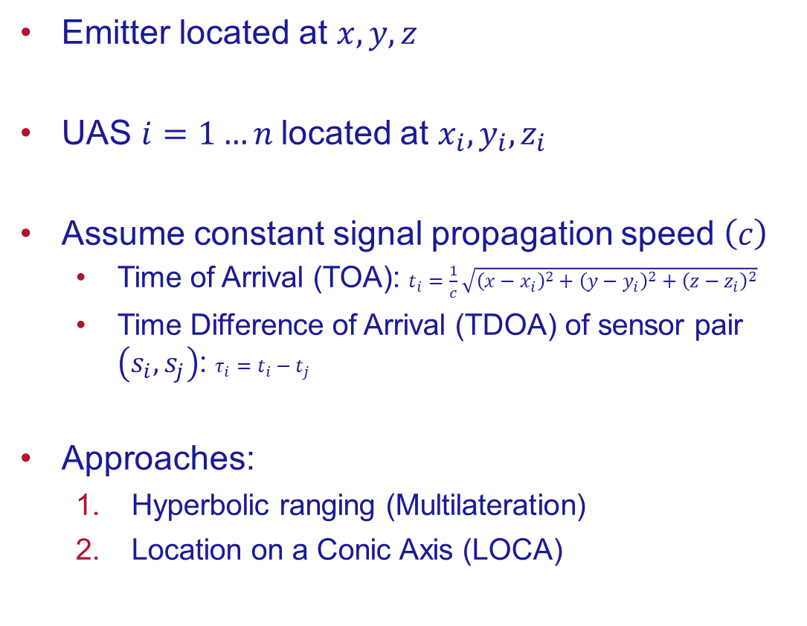
TIMING-BASED LOCALIZATION
Emitter located at $x,y,z$
UAS $i=1…n$located at $x_{i},y_{i},z_{i}$
Assume constant signal propagation speed $\left(c\right)$
Time of Arrival (TOA): $t_{i}=\frac{1}{c}\sqrt{{\left(x−x_{i}\right)}^{2}+{\left(y−y_{i}\right)}^{2}+{\left(z−z_{i}\right)}^{2}}$
Time Difference of Arrival (TDOA) of sensor pair $\left(s_{i},s_{j}\right)$: $τ_{i}=t_{i}−t_{j}$
Approaches:
Hyperbolic ranging (Multilateration)
Location on a Conic Axis (LOCA)
Notes:
Friis free-space signal power
Only parameters are Location & speed

Slide 8
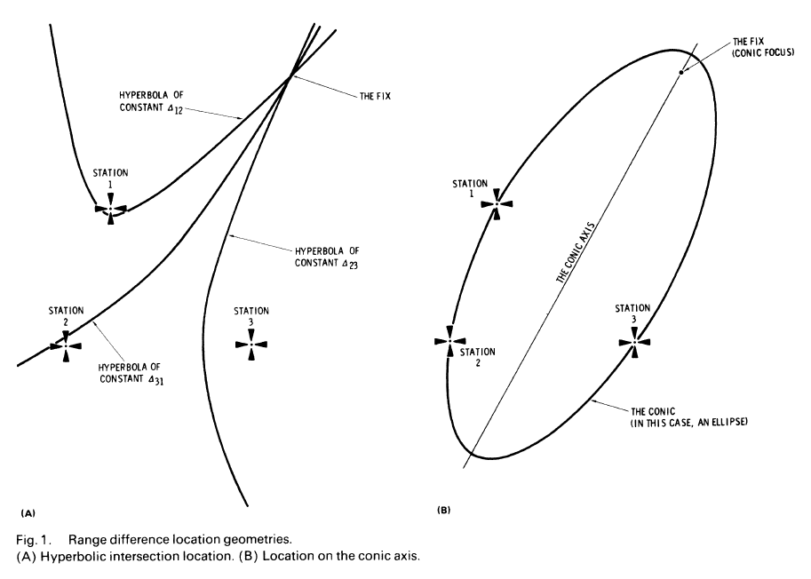
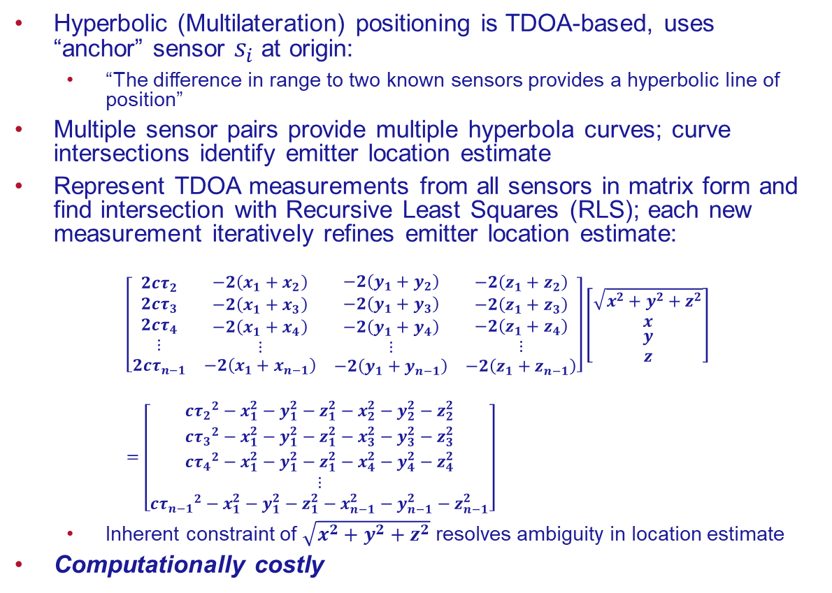
Hyperbolic Range Difference Localization
Hyperbolic (Multilateration) positioning is TDOA-based, uses “anchor” sensor $s_{i}$at origin:
“The difference in range to two known sensors provides a hyperbolic line of position”
Multiple sensor pairs provide multiple hyperbola curves; curve intersections identify emitter location estimate
Represent TDOA measurements from all sensors in matrix form and find intersection with Recursive Least Squares (RLS); each new measurement iteratively refines emitter location estimate:
$$\left[\begin{matrix}\begin{matrix}\begin{matrix}\begin{matrix}2{cτ}_{2} \\ 2{cτ}_{3} \\ 2{cτ}_{4}\end{matrix} \\ ⋮\end{matrix} & \begin{matrix}\begin{matrix}−2\left(x_{1}+x_{2}\right) \\ −2\left(x_{1}+x_{3}\right) \\ −2\left(x_{1}+x_{4}\right)\end{matrix} \\ ⋮\end{matrix} \\ 2{cτ}_{n−1} & −2\left(x_{1}+x_{n−1}\right)\end{matrix} & \begin{matrix}\begin{matrix}\begin{matrix}−2\left(y_{1}+y_{2}\right) \\ −2\left(y_{1}+y_{3}\right) \\ −2\left(y_{1}+y_{4}\right)\end{matrix} \\ ⋮\end{matrix} & \begin{matrix}\begin{matrix}−2\left(z_{1}+z_{2}\right) \\ −2\left(z_{1}+z_{3}\right) \\ −2\left(z_{1}+z_{4}\right)\end{matrix} \\ ⋮\end{matrix} \\ −2\left(y_{1}+y_{n−1}\right) & −2\left(z_{1}+z_{n−1}\right)\end{matrix}\end{matrix}\right]\left[\begin{matrix}\begin{matrix}\sqrt{x^{2}+y^{2}+z^{2}} \\ x\end{matrix} \\ y \\ z\end{matrix}\right]=\left[\begin{matrix}\begin{matrix}{{cτ}_{2}}^{2}−x_{1}^{2}−y_{1}^{2}−z_{1}^{2}−x_{2}^{2}−y_{2}^{2}−z_{2}^{2} \\ {{cτ}_{3}}^{2}−x_{1}^{2}−y_{1}^{2}−z_{1}^{2}−x_{3}^{2}−y_{3}^{2}−z_{3}^{2}\end{matrix} \\ \begin{matrix}{{cτ}_{4}}^{2}−x_{1}^{2}−y_{1}^{2}−z_{1}^{2}−x_{4}^{2}−y_{4}^{2}−z_{4}^{2} \\ ⋮\end{matrix} \\ {{cτ}_{n−1}}^{2}−x_{1}^{2}−y_{1}^{2}−z_{1}^{2}−x_{n−1}^{2}−y_{n−1}^{2}−z_{n−1}^{2}\end{matrix}\right]$$
Inherent constraint of $\sqrt{x^{2}+y^{2}+z^{2}}$ resolves ambiguity in location estimate
Computationally costly
M. D. Gillete and H. F. Silverman, "A Linear Closed-Form Algorithm for Source Localization from Time-Differences of Arrival,” IEEE Signal Processing Letters, vol. 15, pp. 1-4, 2008.
Notes:
Why is Euclidian distance included? Because the real result will have more than one solution, and the constraint allows us to determine the correct solution for the Recursive approach (all solutions must satisfy x, y, z and sqrt)
LSE: Euclidean

Slide 9
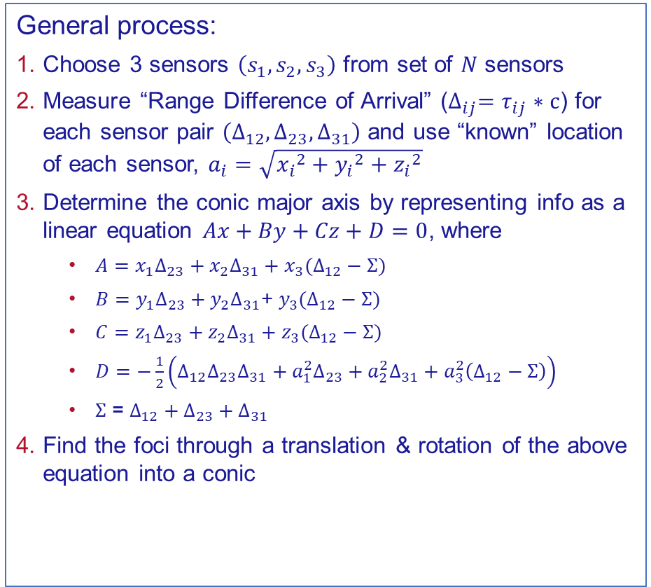
Location on a Conic Axis (LOCA)
LOCA is mathematical “dual” to Hyperbolic Ranging:
“The difference in range to three known sensors provides a straight line of position, which is the major axis of a general conic, a focus of which is the location in question”
Emitter is located at a focus of the conic (ellipse, hyperbola, circle, parabola)
General process:
Choose 3 sensors $\left(s_{1},s_{2},s_{3}\right)$ from set of $N$ sensors
Measure “Range Difference of Arrival” ($∆_{ij}=τ_{ij}∗c$) for each sensor pair $\left(∆_{12},∆_{23},∆_{31}\right)$ and use “known” location of each sensor, $a_{i}=\sqrt{{x_{i}}^{2}+{y_{i}}^{2}+{z_{i}}^{2}}$
Determine the conic major axis by representing info as a linear equation $Ax+By+Cz+D=0$, where
$A=x_{1}∆_{23}+x_{2}∆_{31}+x_{3}(∆_{12}−Σ)$
$B=y_{1}∆_{23}+y_{2}∆_{31}\text{+} y_{3}(∆_{12}−Σ)$
$C=z_{1}∆_{23}+z_{2}∆_{31}+z_{3}(∆_{12}−Σ)$
$D=−\frac{1}{2}\left(∆_{12}∆_{23}∆_{31}+a_{1}^{2}∆_{23}+a_{2}^{2}∆_{31}+a_{3}^{2}\left(∆_{12}−Σ\right)\right)$
$Σ$ = $∆_{12}+∆_{23}+∆_{31}$
Find the foci through a translation & rotation of the above equation into a conic
R. O. Schmidt, "A new approach to geometry of range difference location," IEEE Transactions on Aerospace and Electronic Systems, Vols. AES-8, no. 6, pp. 821-835, 1972.
Notes:
Opposite scenario to Hyperbolic – lines are easier to compute than curves
Don’t talk about challenges in conics yet

Slide 10
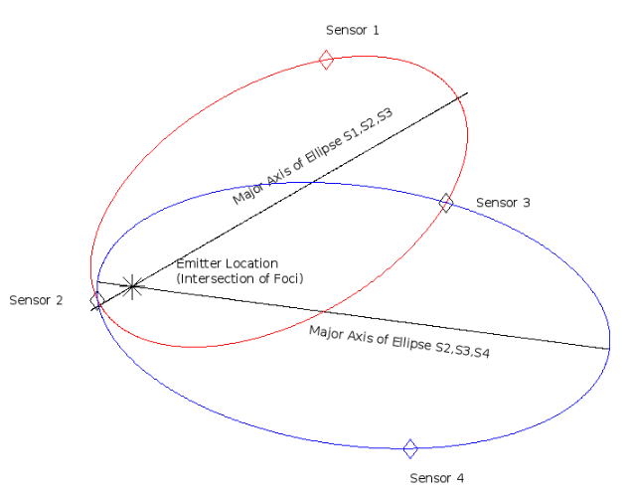
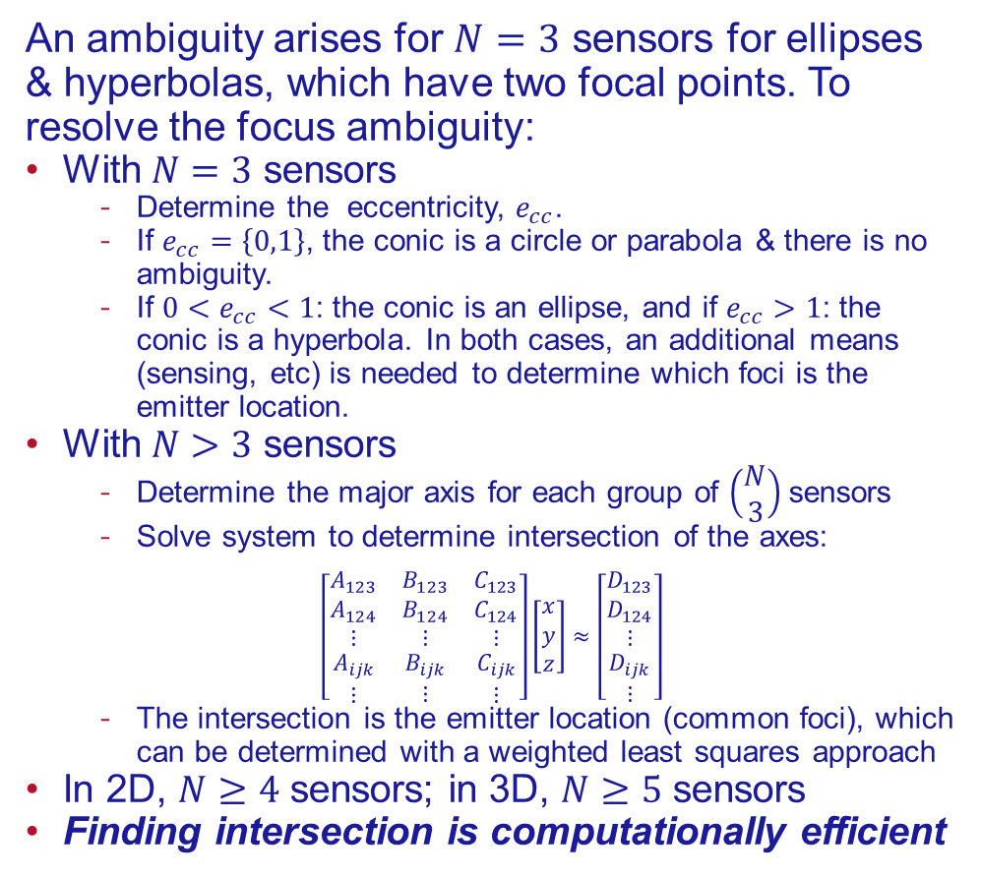
Location on a Conic Axis (LOCA)
An ambiguity arises for $N=3$ sensors for ellipses & hyperbolas, which have two focal points. To resolve the focus ambiguity:
With $N=3$ sensors
Determine the eccentricity, $e_{cc}$.
If $e_{cc}=\left\{0,1\right\}$, the conic is a circle or parabola & there is no ambiguity.
If $0<e_{cc}<1$: the conic is an ellipse, and if $e_{cc}>1$: the conic is a hyperbola. In both cases, an additional means (sensing, etc) is needed to determine which foci is the emitter location.
With $N>3$ sensors
Determine the major axis for each group of $\left(\begin{matrix}N \\ 3\end{matrix}\right)$sensors
Solve system to determine intersection of the axes:
$$\left[\begin{matrix}\begin{matrix}\begin{matrix}A_{123} \\ A_{124}\end{matrix} \\ \begin{matrix}⋮ \\ \begin{matrix}A_{ijk} \\ ⋮\end{matrix}\end{matrix}\end{matrix} & \begin{matrix}\begin{matrix}B_{123} \\ B_{124}\end{matrix} \\ \begin{matrix}⋮ \\ \begin{matrix}B_{ijk} \\ ⋮\end{matrix}\end{matrix}\end{matrix} & \begin{matrix}\begin{matrix}C_{123} \\ C_{124}\end{matrix} \\ \begin{matrix}⋮ \\ \begin{matrix}C_{ijk} \\ ⋮\end{matrix}\end{matrix}\end{matrix}\end{matrix}\right]\left[\begin{matrix}x \\ y \\ z\end{matrix}\right]≈\left[\begin{matrix}\begin{matrix}D_{123} \\ D_{124}\end{matrix} \\ \begin{matrix}⋮ \\ \begin{matrix}D_{ijk} \\ ⋮\end{matrix}\end{matrix}\end{matrix}\right]$$
The intersection is the emitter location (common foci), which can be determined with a weighted least squares approach
In 2D, $N≥4$ sensors; in 3D, $N≥5$ sensors
Finding intersection is computationally efficient
Figure: Example of 4 UAS sensors, UAS sensor triad 1 (S1,S2,S3) and UAS sensor triad 2 (S2,S3,S4) form ellipses with intersecting major axes at emitter location: a common focus of each ellipse.
Notes:
Line intersections found easier than curve intersections
If sensors are in a line, both foci at infinity (don’t do this!)

Slide 11
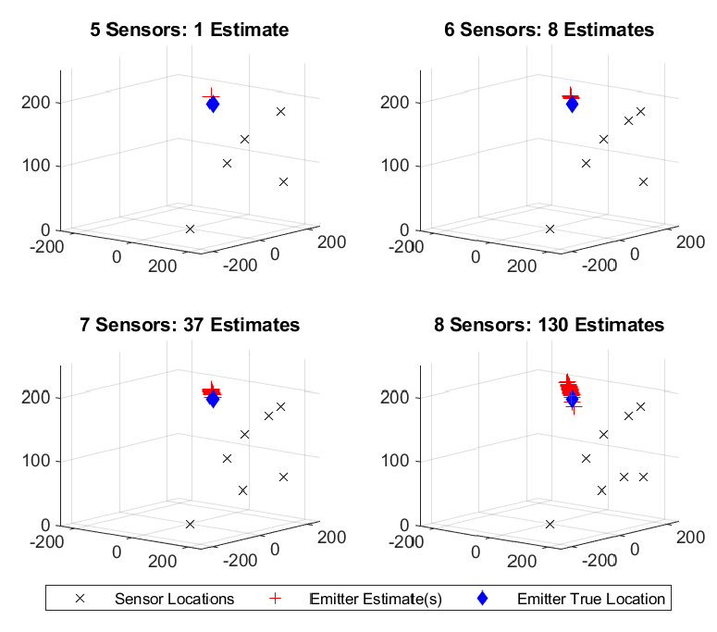
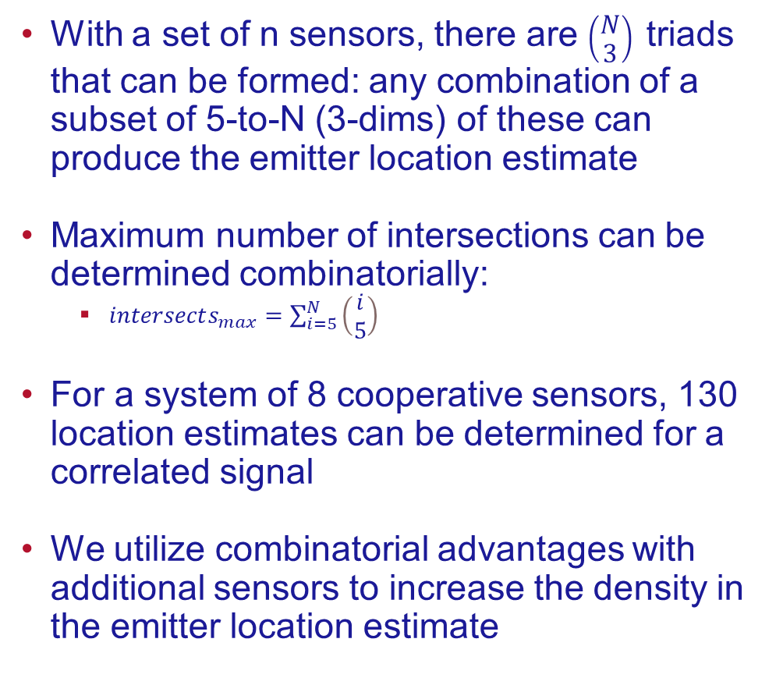
Advantages of LOCA: Multiple Estimates
With a set of n sensors, there are $\left(\begin{matrix}N \\ 3\end{matrix}\right)$ triads that can be formed: any combination of a subset of 5-to-N (3-dims) of these can produce the emitter location estimate
Maximum number of intersections can be determined combinatorially:
$intersects_{max}=\sum_{i=5}^{N}{\left(\begin{matrix}i \\ 5\end{matrix}\right)}$
For a system of 8 cooperative sensors, 130 location estimates can be determined for a correlated signal
We utilize combinatorial advantages with additional sensors to increase the density in the emitter location estimate

Slide 12
Sources of Error

Slide 13
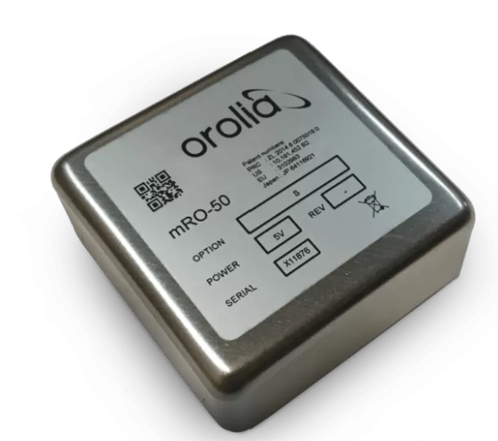
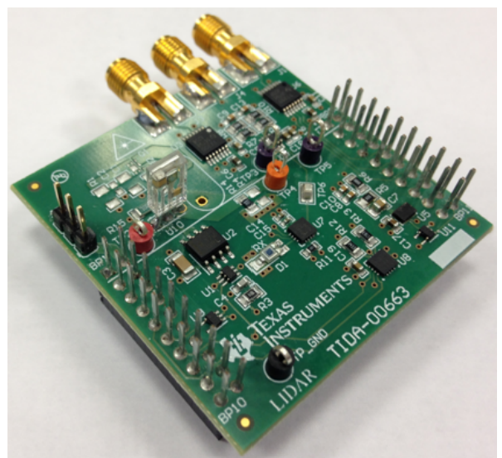
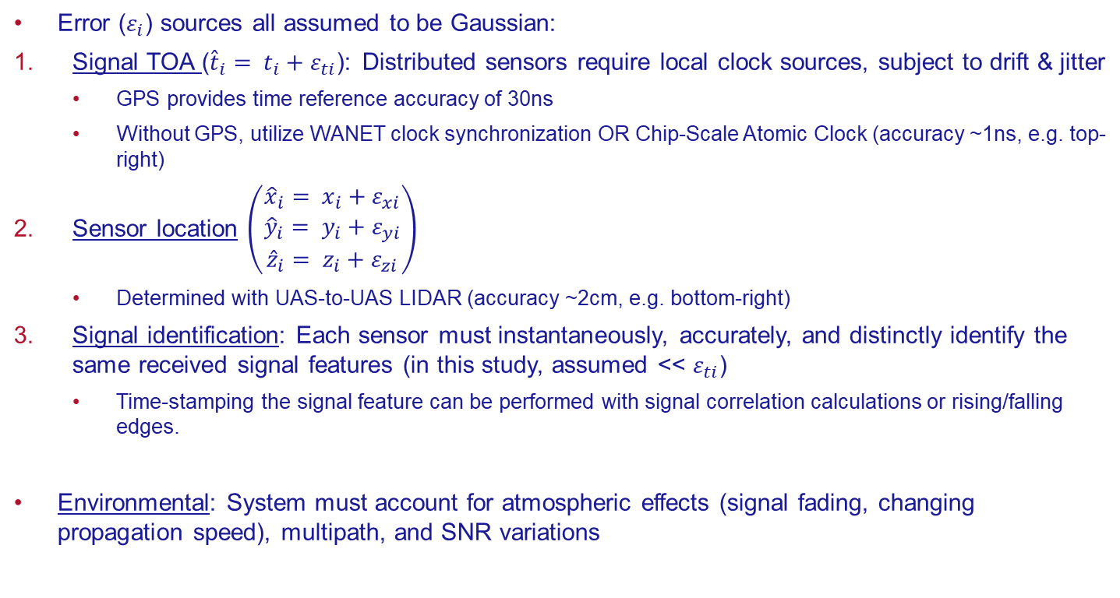
LOCALIZATION ERROR SOURCES
Error ($ε_{i}$) sources all assumed to be Gaussian:
Signal TOA (${\hat{t}}_{i}= t_{i}+ε_{ti}$): Distributed sensors require local clock sources, subject to drift & jitter
GPS provides time reference accuracy of 30ns
Without GPS, utilize WANET clock synchronization OR Chip-Scale Atomic Clock (accuracy ~1ns, e.g. top-right)
Sensor location $\left(\begin{matrix}{\hat{x}}_{i}= x_{i}+ε_{xi} \\ {\hat{y}}_{i}= y_{i}+ε_{yi} \\ {\hat{z}}_{i}= z_{i}+ε_{zi}\end{matrix}\right)$
Determined with UAS-to-UAS LIDAR (accuracy ~2cm, e.g. bottom-right)
Signal identification: Each sensor must instantaneously, accurately, and distinctly identify the same received signal features (in this study, assumed << $ε_{ti}$)
Time-stamping the signal feature can be performed with signal correlation calculations or rising/falling edges.
Environmental: System must account for atmospheric effects (signal fading, changing propagation speed), multipath, and SNR variations
A
mRO-50 - Orolia
J. Kitching, "Chip-scale Atomic Devices," Applied Physics Letters, 5(3):031302, 2018.
B
C. Peters and M. A. Thornton, Cooperative UAS geolocation of emitters with multi-sensor-bounded timing and localization error, in 2023 IEEE Aerospace Conference, 2023, pp. 1-13.
C. Peters and M. A. Thornton, Evaluation of environmental and accumulated errors in localization with cooperative UAS arrays, in 2024 IEEE Wireless and Microwave Technology Conference, 2024, article submitted for publication.
Texas Instruments, "TI LIDAR Pulsed Time of Flight Reference Design," [Online]. Available: https://www.ti.com/lit/pdf/tiducm1b. [Accessed 03 October 2022].
Notes:
Atomic clock: Orolia in Switzerland (CSACs, small form factor): low drift & low jitter; synchronized pre-mission
Methods for sub-nanosecond accuracy in the papers cited with COTS Wifi cards
GPS location accuracy (30ns = 30 ft)

Slide 14
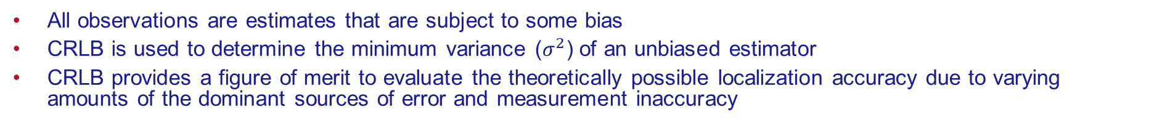
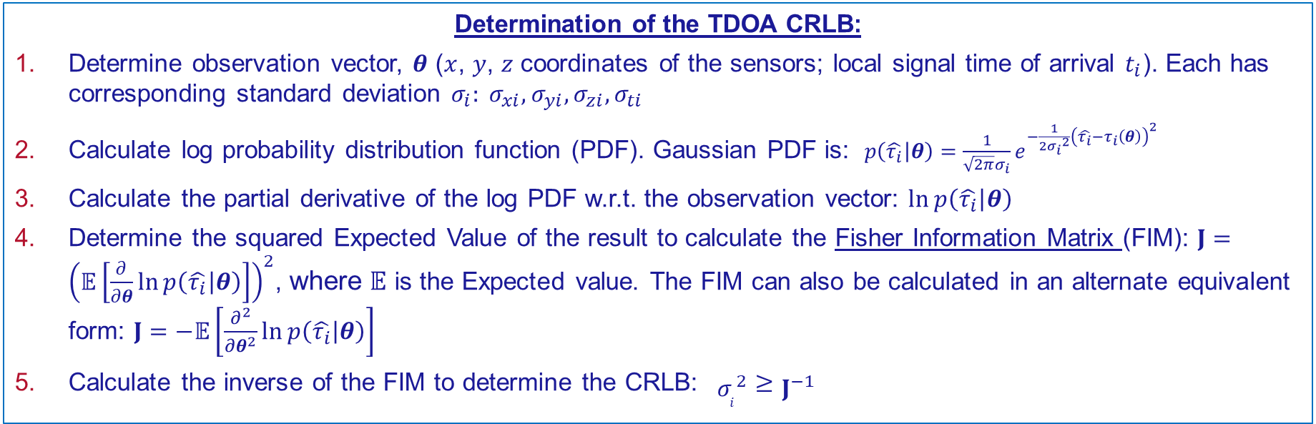
Cramér-Rao Lower Bound (CRLB) Background
All observations are estimates that are subject to some bias
CRLB is used to determine the minimum variance ($σ^{2}$) of an unbiased estimator
CRLB provides a figure of merit to evaluate the theoretically possible localization accuracy due to varying amounts of the dominant sources of error and measurement inaccuracy
Determination of the TDOA CRLB:
Determine observation vector, $θ$ ($x$, $y$, $z$ coordinates of the sensors; local signal time of arrival $t_{i}$). Each has corresponding standard deviation $σ_{i}: {σ_{xi}, σ_{yi}, σ_{zi},σ}_{ti}$
Calculate log probability distribution function (PDF). Gaussian PDF is: $p\left(\left.\hat{τ_{i}}\right|θ\right)=\frac{1}{\sqrt{2π}σ_{i}}e^{−\frac{1}{2{σ_{i}}^{2}}{\left(\hat{τ_{i}}−τ_{i}\left(θ\right)\right)}^{2}}$
Calculate the partial derivative of the log PDF w.r.t. the observation vector: $\ln{p\left(\left.\hat{τ_{i}}\right|θ\right)}$
Determine the squared Expected Value of the result to calculate the Fisher Information Matrix (FIM): $J={\left(𝔼\left[\frac{∂}{∂θ}\ln{p\left(\left.\hat{τ_{i}}\right|θ\right)}\right]\right)}^{2}$, where $𝔼$ is the Expected value. The FIM can also be calculated in an alternate equivalent form: $J=−𝔼\left[\frac{∂^{2}}{∂θ^{2}}\ln{p\left(\left.\hat{τ_{i}}\right|θ\right)}\right]$
Calculate the inverse of the FIM to determine the CRLB: ${σ_{i}}^{2}≥J^{−1}$
R. Kaune, J. Hörst and W. Koch, "Accuracy analysis for TDOA localization in sensor networks," in proc., 14th International Conference on Information Fusion, pp. 1-8, 2011.
Notes:
Standard Deviation ($σ_{i}$) is the Square Root of Variance (${σ_{i}}^{2}$)
FIM can be in time or range domain depending on error terms in covariance matrix

Slide 15
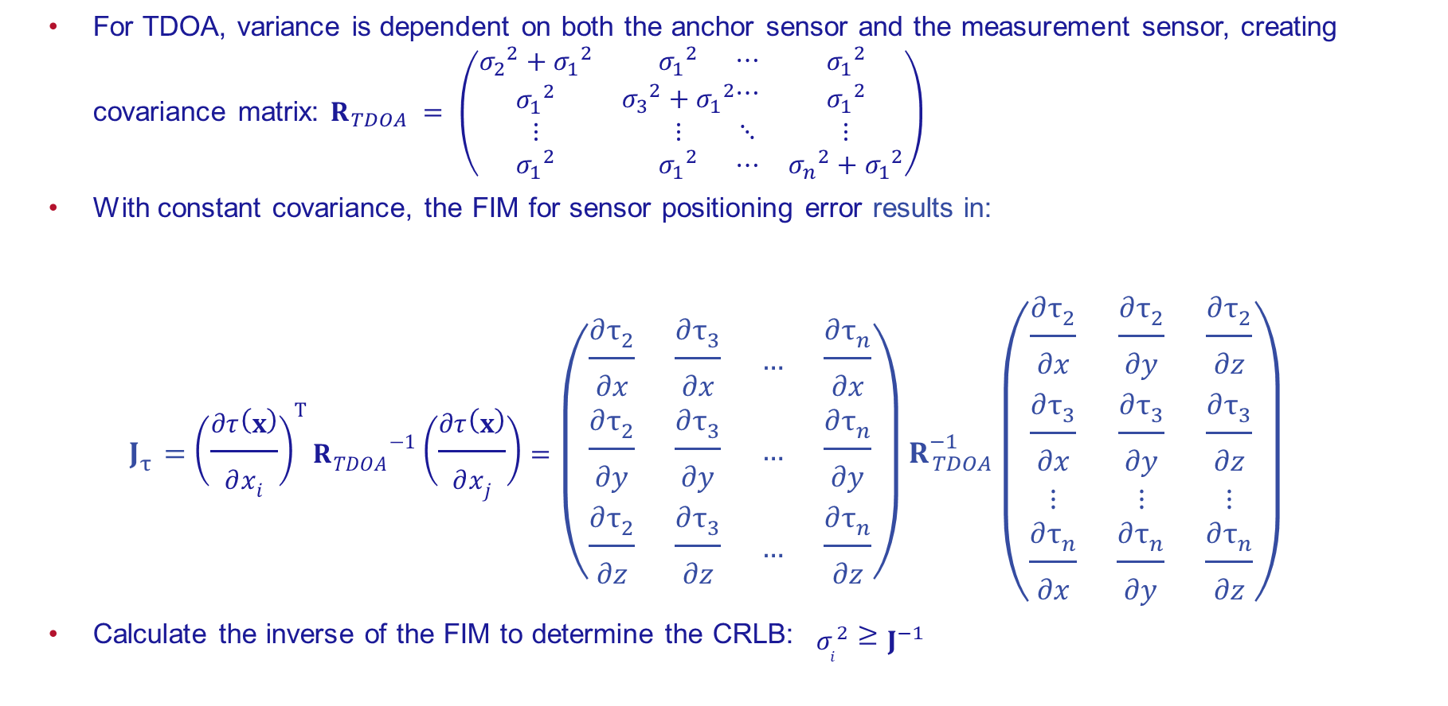
CRLB for Sensor Position Errors
For TDOA, variance is dependent on both the anchor sensor and the measurement sensor, creating covariance matrix: $R_{TDOA} = \left(\begin{matrix}\begin{matrix}{σ_{2}}^{2}+{σ_{1}}^{2} \\ {σ_{1}}^{2}\end{matrix} & \begin{matrix}{σ_{1}}^{2} \\ {σ_{3}}^{2}+{σ_{1}}^{2}\end{matrix} \\ ⋮ & ⋮ \\ {σ_{1}}^{2} & {σ_{1}}^{2}\end{matrix}\begin{matrix}\begin{matrix}⋯ \\ ⋯\end{matrix} & \begin{matrix}{σ_{1}}^{2} \\ {σ_{1}}^{2}\end{matrix} \\ ⋱ & ⋮ \\ ⋯ & {σ_{n}}^{2}+{σ_{1}}^{2}\end{matrix}\right)$
With constant covariance, the FIM for sensor positioning error results in:
$$J_{τ}={\left(\frac{∂τ\left(x\right)}{∂x_{i}}\right)}^{T}{R_{TDOA}}^{−1}\left(\frac{∂τ\left(x\right)}{∂x_{j}}\right)=\left(\begin{matrix}\frac{∂τ_{2}}{∂x} & \frac{∂τ_{3}}{∂x} & … & \frac{∂τ_{n}}{∂x} \\ \frac{∂τ_{2}}{∂y} & \frac{∂τ_{3}}{∂y} & … & \frac{∂τ_{n}}{∂y} \\ \frac{∂τ_{2}}{∂z} & \frac{∂τ_{3}}{∂z} & … & \frac{∂τ_{n}}{∂z}\end{matrix}\right)R_{TDOA}^{−1}\left(\begin{matrix}\frac{∂τ_{2}}{∂x} & \frac{∂τ_{2}}{∂y} & \frac{∂τ_{2}}{∂z} \\ \frac{∂τ_{3}}{∂x} & \frac{∂τ_{3}}{∂y} & \frac{∂τ_{3}}{∂z} \\ ⋮ & ⋮ & ⋮ \\ \frac{∂τ_{n}}{∂x} & \frac{∂τ_{n}}{∂y} & \frac{∂τ_{n}}{∂z}\end{matrix}\right)$$
Calculate the inverse of the FIM to determine the CRLB: ${σ_{i}}^{2}≥J^{−1}$
R. Kaune, J. Hörst and W. Koch, "Accuracy analysis for TDOA localization in sensor networks," in proc., 14th International Conference on Information Fusion, pp. 1-8, 2011.

Slide 16
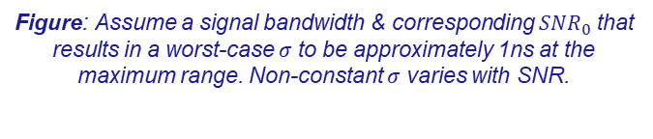
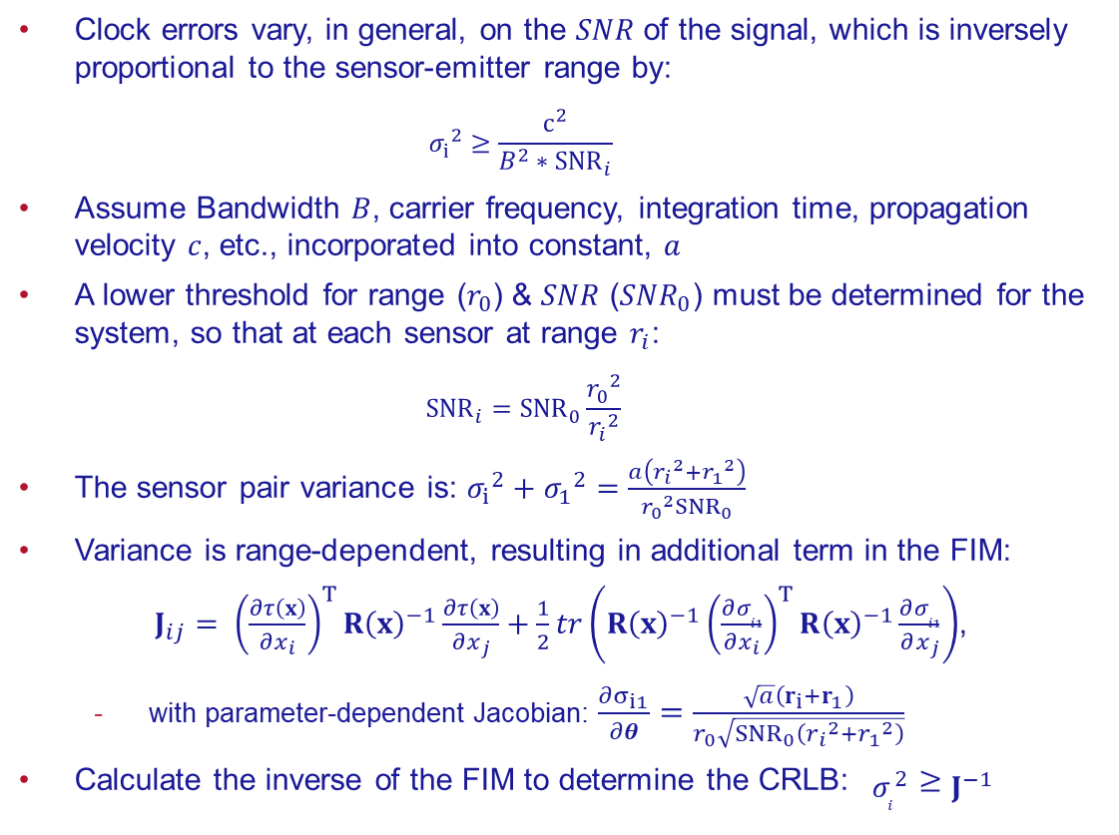
CRLB for Local Timing Inaccuracy
Figure: Assume a signal bandwidth & corresponding ${SNR}_{0}$ that results in a worst-case $σ$ to be approximately 1ns at the maximum range. Non-constant $σ$ varies with SNR.
Clock errors vary, in general, on the $SNR$ of the signal, which is inversely proportional to the sensor-emitter range by:
$${σ_{i}}^{2}≥\frac{c^{2}}{{B^{2}∗SNR}_{i}}$$
Assume Bandwidth $B$, carrier frequency, integration time, propagation velocity $c$, etc., incorporated into constant, $a$
A lower threshold for range ($r_{0}$) & $SNR$ (${SNR}_{0}$) must be determined for the system, so that at each sensor at range $r_{i}$:
$${SNR}_{i}={SNR}_{0}\frac{{r_{0}}^{2}}{{r_{i}}^{2}}$$
The sensor pair variance is: ${σ_{i}}^{2}+{σ_{1}}^{2}=\frac{a\left({r_{i}}^{2}+{r_{1}}^{2}\right)}{{{r_{0}}^{2}SNR}_{0}}$
Variance is range-dependent, resulting in additional term in the FIM:
$J_{ij}= {\left(\frac{∂τ\left(x\right)}{∂x_{i}}\right)}^{T}{R\left(x\right)}^{−1}\frac{∂τ\left(x\right)}{∂x_{j}}+\frac{1}{2}tr\left({R\left(x\right)}^{−1}{\left(\frac{∂σ_{i1}}{∂x_{i}}\right)}^{T}{R\left(x\right)}^{−1}\frac{∂σ_{i1}}{∂x_{j}}\right)$,
with parameter-dependent Jacobian: $\frac{∂σ_{i1}}{∂θ}=\frac{\sqrt{a}\left(r_{i}+r_{1}\right)}{r_{0}\sqrt{{SNR}_{0}\left({r_{i}}^{2}+{r_{1}}^{2}\right)}}$
Calculate the inverse of the FIM to determine the CRLB: ${σ_{i}}^{2}≥J^{−1}$
R. Kaune, J. Hörst and W. Koch, "Accuracy analysis for TDOA localization in sensor networks," in proc., 14th International Conference on Information Fusion, pp. 1-8, 2011.
Notes:
Create a constant, a that combines all terms
We expect a processing gain with increased sensors

Slide 17
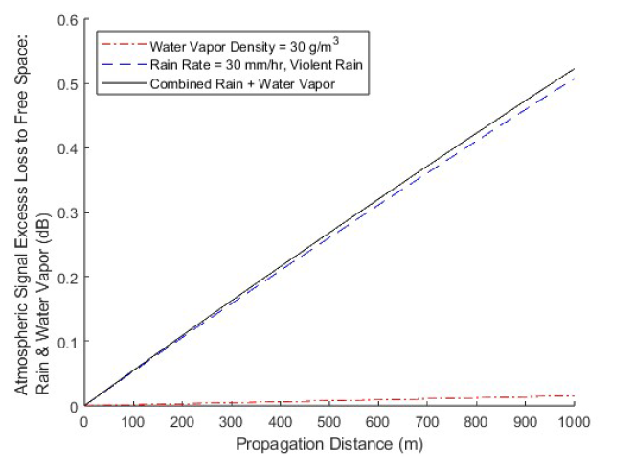
Atmospheric Error Model
Crane Model used for RF signal attenuation due to rainfall & water vapor (gas)
Model can be modified for varying rain rates, temperatures, vapor densities, operating frequencies, and range
At 1km for a 5 GHz signal, even worst-case conditions only achieve additional ~0.5dB loss
Max Rain Rate (30mm/hr) ~ 0.5dB excess loss
Max Water Vapor (30g/m³) ~0.02dB excess loss
At UAS heights < 1km & 5 GHz, other environmental impacts are not considered
Fog model is only significant above 10GHz
Ionospheric, tropospheric, etc occur at higher altitudes
The MathWorks, Inc. (2023). Communications Toolbox version: 8 (R2023a). Available: https://www.mathworks.com. [Accessed 08 August 2023].
Crane, Robert K. Electromagnetic Wave Propagation through Rain. Wiley, 1996.
Notes:
Emergency transponder beacon
GPS constraints
MINIMAL MEASUREMENTS & COMPUTATIONS
Time-based because phase coherence is challenging among array receivers
Pros: Small UASs allows for more challenging/dynamic mission environments that large aircraft cannot penetrate
Cons: carrying capacity (power, payloads); coupling the RF apertures

Slide 18
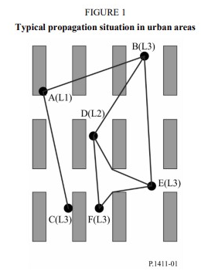
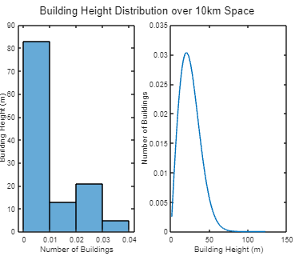
Multipath Error ITU-R 1411 Pathloss Model
International Telecommunication Union Recommendation 1411 formulates Path Loss in Urban environments, incorporating building & street effects for Multipath, using single-bounce geometry
Model is height & frequency dependent
Heights are shown in figure, where L1 is above rooftop, L2 is below rooftop, L3 is very close to the ground
Each height & building condition is incorporated into model
Stochastic models of city consider building heights as Rayleigh-distributed, using an average height
Line-of-Sight (LoS) and Non-LoS Path Loss include random variables to account for building distribution and are specific to transmitter/receiver heights
Incorporates both a "General" (average) model, and a "Site-Specific" model where a user can provide city data for Ray Tracing
Incorporates building & street volumes for the following city scenarios:
Urban High-Rise, Urban Low-Rise, Suburban, Residential
Scenario | Average Building Height (hr, γ) | Average Street Width (w) | Average Building Width (b) | % Land area covered by buildings (α) | Density of buildings (β)
Urban High-Rise | 50 | 20.4 | 40.8 | 0.5 | 300
Urban Low-Rise | 20 | 20.4 | 40.8 | 0.5 | 300
Suburban | 15 | 12.25 | 24.5 | 0.3 | 500
Residential | 8 | 5.8 | 11.6 | 0.1 | 750
Radiocommunication Sector of International Telecommunication Union, "Propagation data and prediction methods for the planning of short-range outdoor radiocommunication systems and radio local area networks in the frequency range 300 MHz to 100 GHz", Rec. ITU-R P. 1411–11 ITU Recommendation, Sep. 2021.
Notes:
Emergency transponder beacon
GPS constraints
MINIMAL MEASUREMENTS & COMPUTATIONS
Time-based because phase coherence is challenging among array receivers
Pros: Small UASs allows for more challenging/dynamic mission environments that large aircraft cannot penetrate
Cons: carrying capacity (power, payloads); coupling the RF apertures

Slide 19
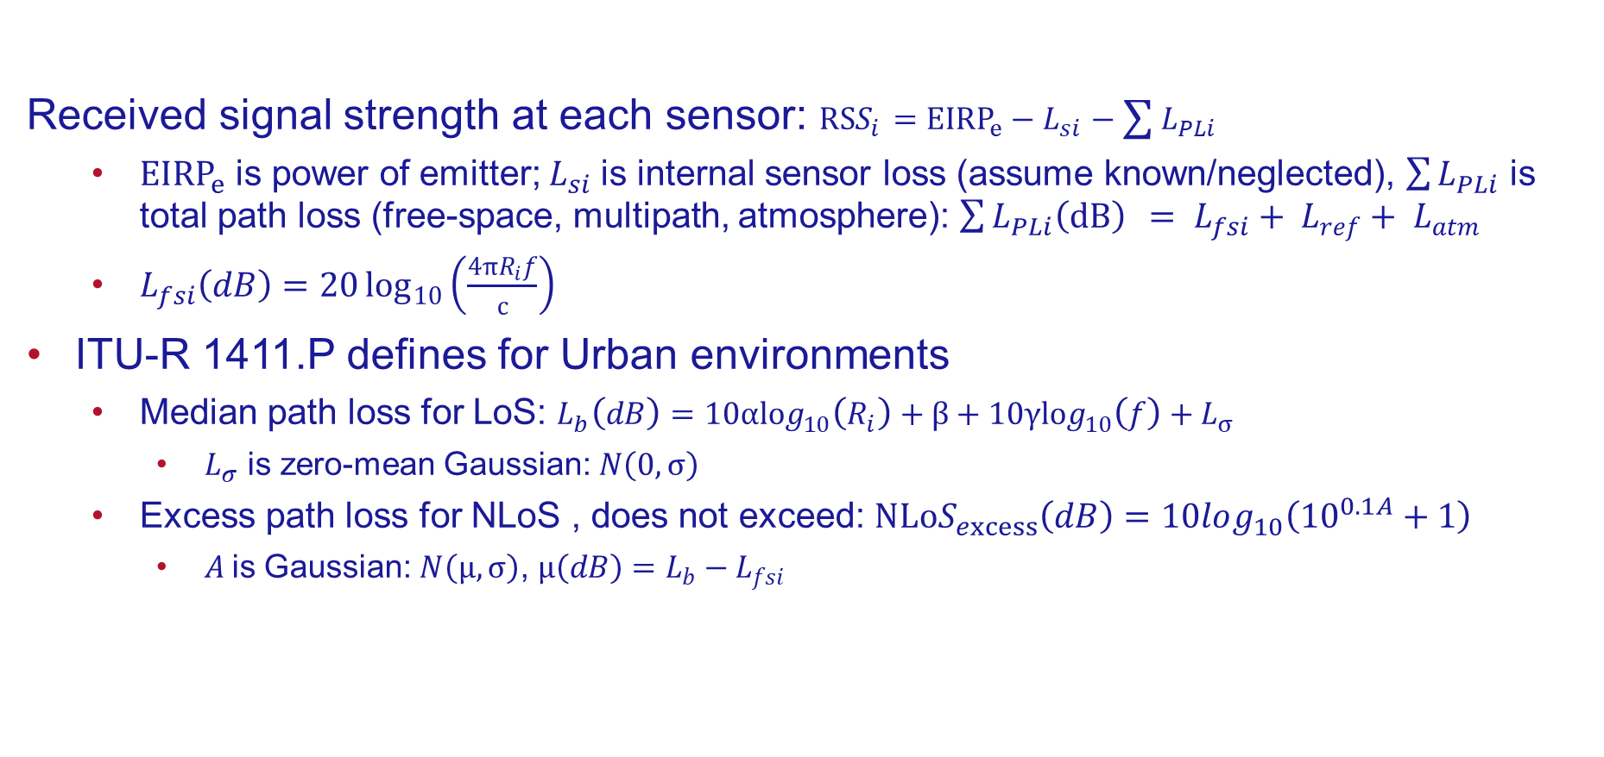
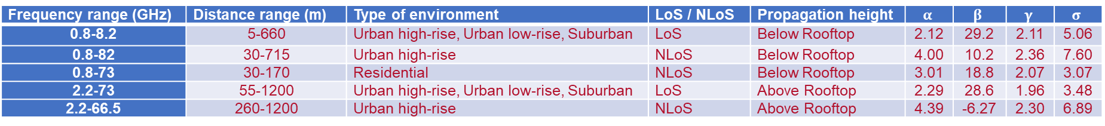
Summary Pathloss
Received signal strength at each sensor: $RSS_{i}={EIRP}_{e}−L_{si}−\sum{L_{PLi}}$
${EIRP}_{e}$ is power of emitter; $L_{si}$is internal sensor loss (assume known/neglected), $\sum{L_{PLi}}$ is total path loss (free-space, multipath, atmosphere): $\sum{L_{PLi}\left(dB\right)} = L_{fsi}+ L_{ref}+ L_{atm}$
$L_{fsi}\left(dB\right)=20\log_{10}\left(\frac{4πR_{i}f}{c}\right)$
ITU-R 1411.P defines for Urban environments
Median path loss for LoS: $L_{b}\left(dB\right)=10αlog_{10}\left(R_{i}\right)+β+10γlog_{10}\left(f\right)+L_{σ}$
$L_{σ}$ is zero-mean Gaussian: $N\left(0,σ\right)$
Excess path loss for NLoS , does not exceed: $NLoS_{excess}\left(dB\right)=10log_{10}\left({10}^{0.1A}+1\right)$
$A$is Gaussian: $N\left(μ,σ\right)\text{,}$ $μ\left(dB\right)=L_{b}−L_{fsi}$
Frequency range (GHz) | Distance range (m) | Type of environment | LoS / NLoS | Propagation height | $$α$$ | $$β$$ | $$γ$$ | $$σ$$
0.8-8.2 | 5-660 | Urban high-rise, Urban low-rise, Suburban | LoS | Below Rooftop | 2.12 | 29.2 | 2.11 | 5.06
0.8-82 | 30-715 | Urban high-rise | NLoS | Below Rooftop | 4.00 | 10.2 | 2.36 | 7.60
0.8-73 | 30-170 | Residential | NLoS | Below Rooftop | 3.01 | 18.8 | 2.07 | 3.07
2.2-73 | 55-1200 | Urban high-rise, Urban low-rise, Suburban | LoS | Above Rooftop | 2.29 | 28.6 | 1.96 | 3.48
2.2-66.5 | 260-1200 | Urban high-rise | NLoS | Above Rooftop | 4.39 | -6.27 | 2.30 | 6.89
Radiocommunication Sector of International Telecommunication Union, "Propagation data and prediction methods for the planning of short-range outdoor radiocommunication systems and radio local area networks in the frequency range 300 MHz to 100 GHz", Rec. ITU-R P. 1411–11 ITU Recommendation, Sep. 2021.
Notes:
Emergency transponder beacon
GPS constraints
MINIMAL MEASUREMENTS & COMPUTATIONS
Time-based because phase coherence is challenging among array receivers
Pros: Small UASs allows for more challenging/dynamic mission environments that large aircraft cannot penetrate
Cons: carrying capacity (power, payloads); coupling the RF apertures

Slide 20
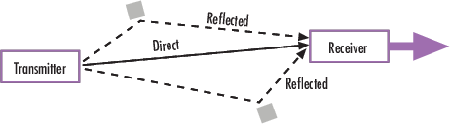
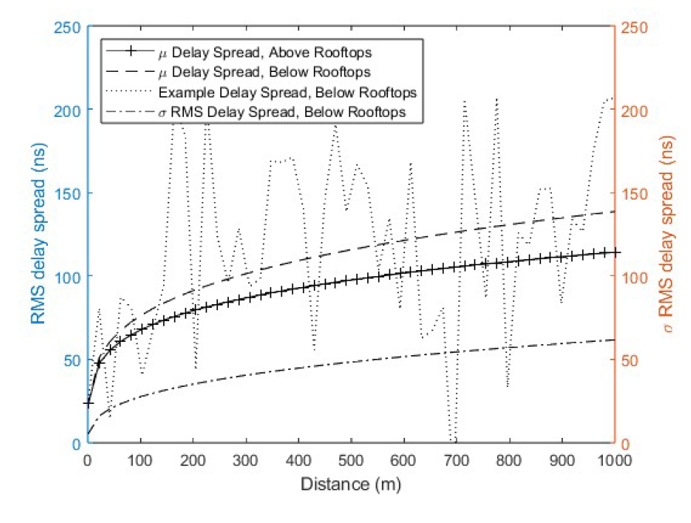
Fading Channel
For dynamic multipath environments, Fast-Fading effects are modeled using a Rician fading channel
MATLAB has a built-in model to simulate Rician fading
Fading Channel Parameters:
Path Loss model: ITU-R 1411, which considers ground scattering & interfering buildings (following a Rayleigh distribution of building height)
LoS average loss (which takes into account ground scattering and interfering buildings)
Non-LoS - impact of the shadowing effects of buildings
Path Delays
By convention, the first delay is typically set to zero. The first delay corresponds to the first arriving path (free space)
Determined LoS & NLoS Path Delays using ITU-R 1411 from above with corresponding distance (time) found from inverting Free-Space formula and delay spread (empirically determined)
K-Factor: Ratio of dominant channel to sum of all other components
~17dB during UAS mission for an open terrain
However, 27.8dB for urban areas
D. W. Matolak and R. Sun, "Air-ground channel characterization for unmanned aircraft systems: The near-urban environment," MILCOM 2015 - 2015 IEEE Military Communications Conference, Tampa, FL, USA, 2015, pp. 1656-1660, doi: 10.1109/MILCOM.2015.7357682.
Notes:
Emergency transponder beacon
GPS constraints
MINIMAL MEASUREMENTS & COMPUTATIONS
Time-based because phase coherence is challenging among array receivers
Pros: Small UASs allows for more challenging/dynamic mission environments that large aircraft cannot penetrate
Cons: carrying capacity (power, payloads); coupling the RF apertures

Slide 21
Simulation Results

Slide 22
Model Assumptions
Cooperative UAS system model assumptions:
5 GHz signal
Omnidirectional sensor & emitter antennas
Fixed emitter location, and fixed (initial) Sensor locations
Constant signal propagation velocity
Signal bandwidth & SNR corresponding to σ=1ns at maximum range
Hardware limitations:
Local UAS clocks synchronized prior to mission, accuracy 1ns
Utilize UAS-UAS LIDAR sensor positioning, accuracy 2cm
Environmental conditions:
Model both Urban "Low-Rise" and Urban "High-Rise“ scenarios
Heavy rain conditions
Notes:
5 Sensors in this diagram; Reference Sensor = UAS 1
Texas Instruments has LIDAR with 1cm at 100m
CSAC options such as Orolio: low drift and jitter; free-running source synced at pre-mission time

Slide 23
Simulations
Simulated 1000 Monte Carlo runs for:
Multipath LoS & NLoS signals, using ITU-R 1411 for pathloss prediction, and Rician fading channel for Multipath
ITU-R 1411 stochastically incorporates scatterers (buildings & streets)
Sensor clock errors (10 ns)
Sensor positioning errors (2 cm)
Atmospheric impact, rain rate = 100 mm/hr ("worst case condition")
Determined “baseline” localization error (no induced error), by applying TDOA & LOCA Algorithms
Simulated localization using LOCA Algorithm for above individual error sources
Determined time error from Multipath by applying calculated pathloss to Free-Space Pathloss formula
Removed outlying datapoints (values > µ + 3σ) to determine mean position
LOCA Algorithm predicts many estimates: utilized most probable
Notes:
5 Sensors in this diagram; Reference Sensor = UAS 1
Texas Instruments has LIDAR with 1cm at 100m
CSAC options such as Orolio: low drift and jitter; free-running source synced at pre-mission time

Slide 24
Baseline Algorithm Results (Error-Free)
In the positioning/timing error-free case, both algorithms showed very low solution error in LSE determination of emitter location
Error values improve approximately logarithmic with increasing sensor quantities
UAS arrays of 5-8 sensors should be sufficient in most applications

Slide 25
Positioning Error Simulation
Varied sensor positioning error with increasing sensor quantities
For TDOA Multilateration, errors were much higher than CRLB, whereas LOCA is much closer to CRLB
For N > 8, impact of sensor positioning error decreased:
LOCA accuracy showed continuous and diminishing improvement
TDOA Multilateration remained constant above 8 sensors: induced errors diminish the processing gains found with increasing sensor quantities
Localization Error increases with increasing positioning error
Utilizing intra-array positioning method provides upper-bound for error

Slide 26
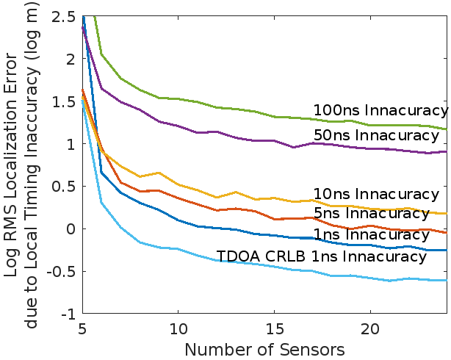
Local Timing Inaccuracy Simulation
Varied local timing inaccuracy with increasing sensor quantities
For TDOA Multilateration, errors were much higher than CRLB, whereas LOCA is much closer to CRLB
For N > 8, impact of local timing inaccuracy decreased:
LOCA accuracy showed continuous, but diminishing, improvement
TDOA Multilateration remained constant above 8 sensors: induced errors diminish the processing gains found with increasing sensor quantities
Simulated increasing local UAS clock inaccuracies and their impact on LOCA performance
Cooperative use of increasing sensors quantities can overcome local timing inaccuracies if 1ns is unachievable in a geometry
Example implementation:
Large array with low clock accuracy obtains initial emitter location estimate
Synchronized subset of array obtains subsequent, more accurate estimate and in a closer range
Initial emitter location estimate used to select ideal UAS subset, new geometries, and different algorithm with improved performance

Slide 27
Environmental Errors
Mean localization error improves with increasing UAS array size, but not for more than 8-10 sensors
Urban high-rise multipath error is consistently higher than urban low-rise multipath error
Atmospheric scattering provides lowest error impact

Slide 28
Multipath Error Density: Advantages of LOCA
Mean localization error improves with increasing UAS array size
Most significant improvement when increasing from five to six sensors
Density of high accuracy increases with quantity of sensors, due to the combinatorial advantages of the LOCA algorithm

Slide 29
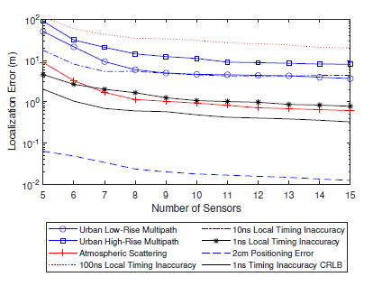
Summary of Error Analysis
Error impact decreases with increasing sensor quantity, up to 8 sensors
Atmospheric scattering provides a much lower localization error than multipath and is on a similar order as a system with 1 ns local timing inaccuracy
System in urban low-rise multipath environment operates with similar accuracy as a system with 10 ns local timing inaccuracy
System in urban high-rise multipath scenario provides higher error than low-rise, but better than a system with 100 ns timing inaccuracy
An “accumulated error” metric is a summation of all impacts (dependent on urban scenario)

Slide 30
Proposal for Future Studies

Slide 31
Proposal for Future Studies
*Dynamic Reconfiguration: Primary Goal
Dynamically reconfiguring the UAS array, informed by individual sensor measurements, by the cooperative localization aspects of the system, and by geometric optimization strategies, will inform new sensor positions for time-efficient, computationally-efficient, and highly-accurate emitter localization.
Topics of study for this approach:
Utilization of the combinatorial advantages of the LOCA algorithm (using positions and signal TDOA at the multi-sensor level) to find minimized error ellipse in multiple dimensions
Utilization of optimized geometry (determined from theory and simulations)
Utilization of Reinforcement Learning for the emitter search strategy: Maximize reward based on minimized error ellipse & peak RSS at sensor-level; inform policy utilizing optimized geometry
Other topics of study
Model Expansion for more robust simulations
Empirical Study
Evaluation of Additional Error Sources

Slide 32
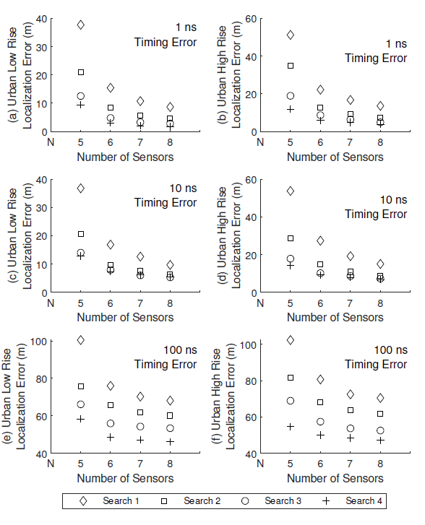
Dynamic Reconfiguration
Dynamically updating geometry to reconfigure for subsequent iterative emitter location measurements will provide large advantage over conventional fixed-array systems. Example implementation:
Larger array with less accurate timing sources can be used to obtain initial emitter location estimate
Synchronized subset of array can be used to obtain subsequent, more accurate estimate and in a closer range
Initial emitter location estimate could be used to select ideal array elements, new geometries, and different algorithm with improved performance
Simulated “basic” approach
After initial localization, moved 3 sensors to ½ distance to emitter
Repeated for 4 measurements
Error improved by more than 25% on each iteration
Notes:
Q- learning: new state determined by maximum reward
Reward from MC sims
Reward from Max gain in bearing angle

Slide 33
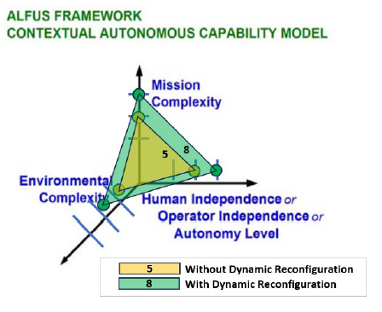
Dynamic Reconfiguration: Advantages
Provides three-axis improvement to NIST ALFUS UAS autonomy capability model framework
Mission complexity: UAS is more adaptable to mission scenario and utilizes sensor feedback for real-time decision updates for localization
Environmental complexity: UAS is less influenced by environment by utilizing peak RSS
Operator independence: geometry is automatically determined, therefore, operator merely provides strategic goals
H.-M. Huang, E. Messina, and J. Albus, Autonomy Levels for Unmanned Systems (ALFUS) Framework, Volume II: Framework Models Version 1.0, National Institute of Standards and Technology, standard, December 2007.
Notes:
Q- learning: new state determined by maximum reward
Reward from MC sims
Reward from Max gain in bearing angle

Slide 34
Minimized Error Approaches
Error Metrics Analysis
Circular Error Probability (CEP): Implement figure-of-merit to define likelihood that calculated emitter location is equivalent to true location in presence of errors, utilizing multivariate confidence region for provided error sources
Spherical Error Probability (SEP): 3-D implementation of CEP
Dilution of Precision (DoP): Determine impacts of errors in measurements impact the resulting location estimate
LOCA
Advantages found with using choices of combinations of sensors, especially when 7 or more sensors are utilized.
Generate error ellipse with each measurement, identify regions of “overlap”
Minimum Error Region
CEP 2
CEP 1
W. E. Hoover and U. S., Algorithms for confidence circles and ellipses, United States National Ocean Service of Charting and Geodetic Services, Tech. Rep., 1984, nOAA technical report NOS 107 C&GS 3. [Online]. Available: https://repository.library.noaa.gov/view/noaa/23141
Notes:
Q- learning: new state determined by maximum reward
Reward from MC sims
Reward from Max gain in bearing angle

Slide 35
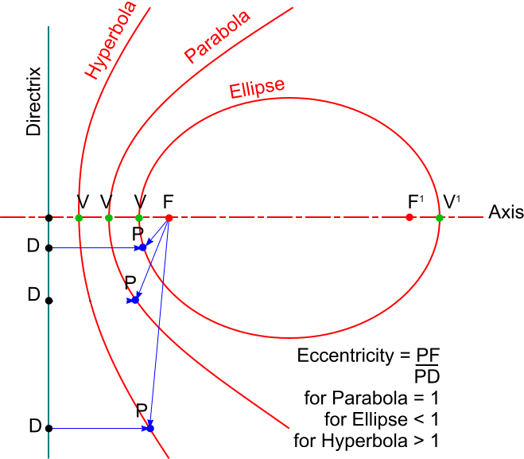
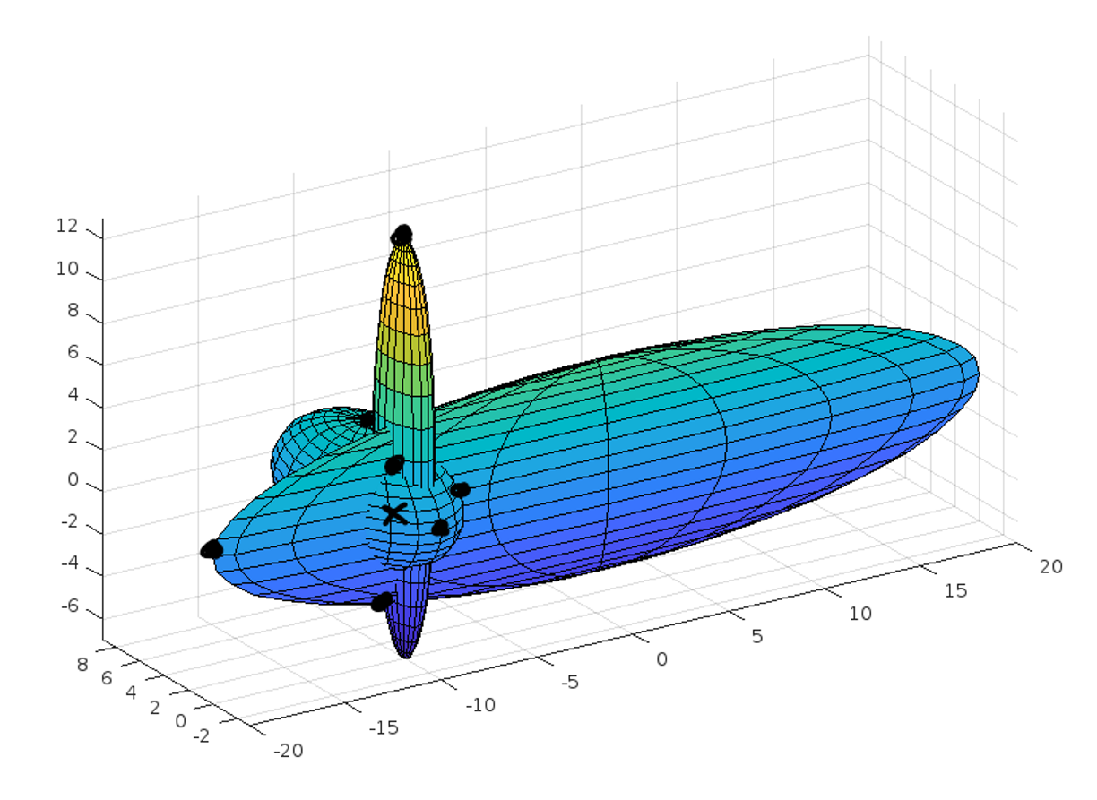
Geometry Optimization
Geometry optimization:
Previous geometries were purely random, which can be starting point
Iterative sensor location updates: utilize geometries corresponding to minimum error
LOCA utilizes conics (emitter at focus, sensors on conic section)
It is to be determined whether specific conic produces minimized error
Determine these from simulations and from theory. One metric to consider is eccentricity
Subsequent measurements use this to dynamically reposition the array or sub-array, simultaneously minimizing the error in the emitter localization and maximizing the cooperative nature of the full set
https://wiki.dtonline.org/index.php/File:Conics-Eccentricity.png

Slide 36
Multi-Agent Reinforcement Learning
Reinforcement Learning-based Geometry & SNR Optimization:
Utilize Multi-Agent Reinforcement Learning approach to optimize the SNR at each sensor by its sensor-emitter orientation and by its coordinate system location
Considered in previous research using peak RSS only
Our approach expands previous research by considering localization algorithms and optimal geometry
State updates:
Initial approach will be probabilistic study of geography
Plan to refine approach utilizing optimized geometries and minimum error
Reward (weighted sum of following):
Improved RSS as determined with emitter location calculated (single sensor)
Improved CEP/SEP radius (multi-sensor) as determined with sensor combinations. Multi-axis CEP can reduce error ellipse in more than one dimension to drive convergence
Study will compare the following RL approaches:
RSS-only (similar to previous studies)
RSS + SEP: improvement over RSS, utilizing combinatorial advantages of LOCA
J. Jyoti and R. S. Batth, Unmanned aerial vehicles (uav) path planning approaches, in 2021 International Conference on Computing Sciences (ICCS), 2021, pp. 76-82.

Slide 37
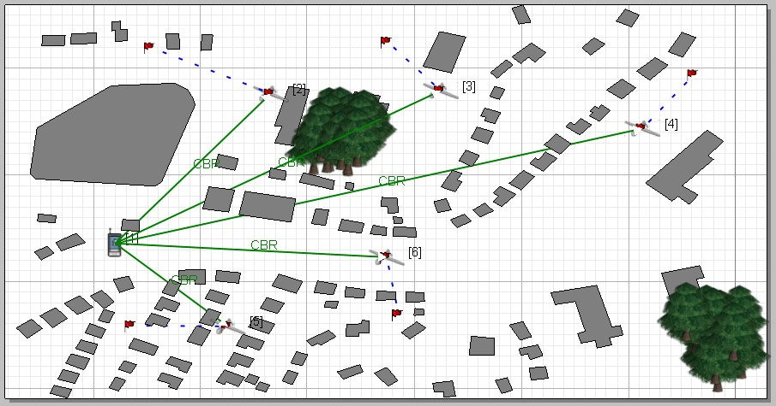
Model Expansion
Model Expansion for Additional Errors
Varying signal propagation velocity: assumed to be constant in this study, but real-world cases should account for atmospheric effects
Time-stamping errors: accurately correlate time-stamped signal across array for different signal definitions
Utilize EXata Network Modeling software from Keysight:
Digital twin of network, including environmental simulations (urban areas, atmosphere) resulting in high-fidelity simulations & emulations
Readily available in SMU Cyber Autonomy Range

Slide 38
Empirical Studies
Empirical Studies
Test the feasibility of cooperative UAS system with real hardware
Network of software defined radios as sensors and emitter, measuring & correlating timestamps
Utilize EXata Network Modeling software from Keysight:
Includes ability to operate with real radio devices in-the-loop to determine exact network performance
Readily available in SMU Cyber Autonomy Range

Slide 39
Other Efforts
Comparison to Alternative Algorithms
Multiple Signal Classification (MUSIC) to correlate signals across multiple sensors
Phase-based correlation: Correlative Interferometer (CORR) and Phase Rotation Algorithm (PRA), assuming the system is capable of accurate & correlated phase measurements
SNR Optimization:
Orientation optimization (non-omnidirectional sensor antennas):
Implement antenna pattern look-up table to correlate antenna gain in emitter direction with expected SNR
Rotate each UAS to align gain peak with emitter bearing

Slide 40
REFERENCES
S. M. Sheikh, H. M. Asif, K. Raahemifar and F. Al-Turjman, "Time Difference of Arrival Based Indoor Positioning System Using Visible Light Communication," IEEE Access, vol. 9, no. 10.1109/ ACCESS.2021.3069793, pp. 52113-52124, 2021.
Texas Instruments, "TI LIDAR Pulsed Time of Flight Reference Design," [Online]. Available: https://www.ti.com/lit/pdf/tiducm1b. [Accessed 03 October 2022].
NOAA, "GPS Accuracy," National Coordination Office for Space-Based Positioning, Navigation, and Timing, 3 March 2022. [Online]. Available: https://www.gps.gov/systems/gps/performance/accuracy/. [Accessed 10 August 2022].
S. Knappe, V. Shah, P.D.D. Schwindt, L. Hollberg, J. Kitching, L.-A. Liew and J. Moreland, John, "A microfabricated atomic clock". Applied Physics Letters. 85 (9): 1460–1462, Aug. 30, 2004.
J. Kitching, "Chip-scale Atomic Devices," Applied Physics Letters, 5(3):031302, 2018.
F. Mekelleche and H. Hafid, "Classification and Comparison of Range-Based Localization Techniques in Wireless Sensor Networks," Journal of Communications, vol. 12, no. 10.12720/jcm.12.4.221-227, pp. 221-227, 2017.
S. R. Leelavathy and S. Sophia , "Providing Localization using Triangulation Method in Wireless Sensor Networks," International Journal of Innovative Technology and Exploring Engineering, vol. 4, no. 6, pp. 47-50, 2014.
A. Paul and T. Sato, "Localization in Wireless Sensor Networks: A Survey on Algorithms, Measurement Techniques, Applications and Challenges," Journal of Sensor and Actuator Networks, vol. 6, no. 4, p. 24, 2017.
M. K. Kumar and V. K. Prasad, “TASLT: Triangular Area Segmentation based Wireless Sensor Network using AoA and RSSI Measures – A New Approach,” in proc., 2021 IEEE 18th International Conference on Mobile Ad Hoc and Smart Systems (MASS), no. 10.1109/MASS52906.2021.00083, pp. 585-590, 2021. pp. 585-590, 2021.
A. Norrdine, "An Algebraic Solution to the Multilateration Problem," in proc., 2012 International Conference on Indoor Positioning and Indoor Navigation (IPIN), 2012.
M. D. Gillete and H. F. Silverman, "A Linear Closed-Form Algorithm for Source Localization from Time-Differences of Arrival,” IEEE Signal Processing Letters, vol. 15, pp. 1-4, 2008.
S. S. Reddi, "An Exact Solution to Range Computation with Time Delay Information for Arbitrary Array Geometries," IEEE Transactions on Signal Processing, vol. 41, no. 1, pp. 485-, 1993.
R. O. Schmidt, "A new approach to geometry of range difference location," IEEE Transactions on Aerospace and Electronic Systems, Vols. AES-8, no. 6, pp. 821-835, 1972.
R. O. Schmidt, "Least Squares Range Difference Location," IEEE Transactions on Aerospace and Electronic Systems, vol. 32, no. 1, pp. 234-242, 1996.
D. Vasisht, S. Kumar and D. Katabi, "Decimeter-Level Localization with a Single WiFi Access Point," in proc., 13th USENIX Symposium on Networked Systems Design and Implementation, vol. NSDI 16, pp. 165-178, 2016.
D. Katabi, D. Vasisht and S. S. Kumar, (inventors), "Sub-Decimeter Radio Frequency Ranging". U.S. Patent 9,961,495, May 1, 2018.
S. Prager, M. S. Haynes and M. Moghaddam, "Wireless Subnanosecond RF Synchronization for Distributed Ultrawideband Software-Defined Radar Networks," IEEE Transactions on Microwave Theory and Techniques, vol. 68, no. 11, pp. 4787-4804, 2020.
L. Hollberg and J. Kitching (inventors), "Miniature Frequency Standard Based on All-optical Excitation and A Micro-machined Containment Vessel". U.S. Patent 6,806,784, Oct. 19, 2004.
Microsemi, "Chip Scale Atomic Clock (CSAC)," Microchip, [Online]. Available: https://www.microsemi.com/product-directory/clocks-frequency-references/3824-chip-scale-atomic-clock-csac. [Accessed 1 October 2022].
L. Zhou, G. Li, Z. Zheng and X. Yang, "TOA Estimation with Cross Correlation-Based Music Algorithm for Wireless Location," in proc., 2014 Fourth International Conference on Communication Systems and Network Technologies, 2014, pp. 862-865, doi: 10.1109/CSNT.2014.179.
C. Knapp and G. Carter, "The Generalized Correlation Method for Estimation of Time Delay," in proc., IEEE Trans. Ac., Spch. and Sig. Proc. (ICASSP), vol. 44, pp. 320-327, 1976.
M. Azaria and D. Hertz, "Time Delay Estimation by Generalized Cross Correlation Methods," in proc., IEEE Trans. Ac., Spch. and Sig. Proc. (ICASSP), vol. 32, pp. 280-285, 1984.
J. Benesty, C. Jingdong and H. Yiteng, "Time-delay Estimation Via Linear Interpolation and Cross Correlation," IEEE Trans. Speech and Audio Proc., vol. 12, pp. 509-519, 2004.
A. Yeredor, "Analysis of the Edge-effects in Frequency-domain TDOA Estimation," in proc., 2012 IEEE International Conference on Acoustics, Speech and Signal Processing (ICASSP), 2012, pp. 3521-3524, doi: 10.1109/ICASSP.2012.6288676.
X. Ning, X. Sha and X. Wu, "A TOA Estimation Method for IR-UWB Ranging Systems," in proc., 2010 First International Conference on Pervasive Computing, Signal Processing and Applications, 2010, pp. 684-687, doi: 10.1109/PCSPA.2010.170.
J. Xu, Z. Wang, Q. Liu and L. Ren, "A novel TOA estimation method for unknown signal based on intra-pulse correlation accumulation," in proc., 2016 IEEE International Conference on Signal Processing, Communications and Computing (ICSPCC), 2016, pp. 1-4, doi: 10.1109/ICSPCC.2016.7753696.
N. Patwari, J. N. Ash, S. Kyperountas, A. O. Hero, R. L. Moses and N. S. Correal, "Locating the Nodes: Cooperative Localization in Wireless Sensor Networks," Signal Processing Magazine, IEEE, vol. 22, pp. 54-69, 2005.
D. J. Torrierri, "Statistical Theory of Passive Location Systems," IEEE Trans. On Aerospace and Electronic Systems, vol. 20, no. 2, pp. 183-198, 1984.
R. Kaune, J. Hörst and W. Koch, "Accuracy analysis for TDOA localization in sensor networks," in proc., 14th International Conference on Information Fusion, pp. 1-8, 2011.
S. M. Kay, Fundamentals of Statistical Signal Processing: Estimation Theory, Prentice Hall PTR, 1993.
Y. Wang and K. C. Ho, "TDOA Source Localization in the Presence of Synchronization Clock Bias and Sensor Position Errors," IEEE Transactions on Signal Processing, vol. 61, no. 18, pp. 4532-4544, 2013.
C. Peters and M. A. Thornton, "Cooperative UAS Geolocation of Emitters with Multi-Sensor-Bounded Timing and Localization Error," 2023 IEEE Aerospace Conference, Big Sky, MT, USA, 2023, pp. 1-13, doi: 10.1109/AERO55745.2023.10116023.
C. Peters and M. A. Thornton, “Evaluation of Environmental and Accumulated Errors in Localization with Cooperative UAS Arrays”, submitted to 2024 IEEE Wireless and Microwave Technology Conference.
W. Khawaja, I. Guvenc, D. W. Matolak, U. -C. Fiebig and N. Schneckenburger, "A Survey of Air-to-Ground Propagation Channel Modeling for Unmanned Aerial Vehicles," in IEEE Communications Surveys & Tutorials, vol. 21, no. 3, pp. 2361-2391, thirdquarter 2019, doi: 10.1109/COMST.2019.2915069.
Radiocommunication Sector of International Telecommunication Union, "Propagation data and prediction methods for the planning of short-range outdoor radiocommunication systems and radio local area networks in the frequency range 300 MHz to 100 GHz", Rec. ITU-R P. 1411–12 ITU Recommendation, Aug. 2023.
Radiocommunication Sector of International Telecommunication Union. Recommendation ITU-R P.838-3: Specific attenuation model for rain for use in prediction methods. P Series, Radiowave Propagation 2005.
Radiocommunication Sector of International Telecommunication Union. Recommendation ITU-R P.676-10: Attenuation by atmospheric gases 2013.
The MathWorks, Inc. (2023). Communications Toolbox version: 8 (R2023a). Available: https://www.mathworks.com. [Accessed 08 August 2023].
Crane, Robert K. Electromagnetic Wave Propagation through Rain. Wiley, 1996.
D. W. Matolak and R. Sun, "Air-ground channel characterization for unmanned aircraft systems: The near-urban environment," MILCOM 2015 - 2015 IEEE Military Communications Conference, Tampa, FL, USA, 2015, pp. 1656-1660, doi: 10.1109/MILCOM.2015.7357682.
J. Holis and P. Pechac, "Elevation Dependent Shadowing Model for Mobile Communications via High Altitude Platforms in Built-Up Areas," in IEEE Transactions on Antennas and Propagation, vol. 56, no. 4, pp. 1078-1084, April 2008, doi: 10.1109/TAP.2008.919209.
H.-M. Huang, E. Messina, and J. Albus, Autonomy Levels for Unmanned Systems (ALFUS) Framework, Volume II: Framework Models Version 1.0, National Institute of Standards and Technology, standard, December 2007.
W. E. Hoover and U. S., Algorithms for confidence circles and ellipses, United States National Ocean Service of Charting and Geodetic Services, Tech. Rep., 1984, nOAA technical report NOS 107 C&GS 3. [Online]. Available: https://repository.library.noaa.gov/view/noaa/23141
J. Jyoti and R. S. Batth, Unmanned aerial vehicles (uav) path planning approaches, in 2021 International Conference on Computing Sciences (ICCS), 2021, pp. 76-82.

Slide 41
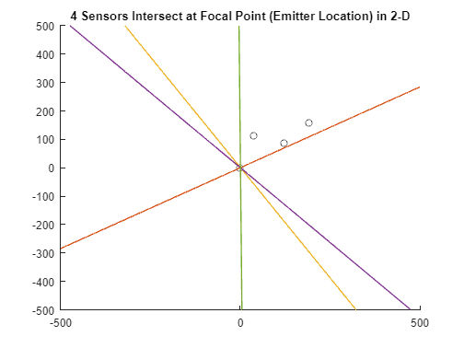
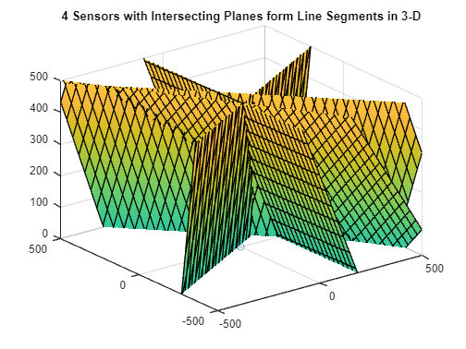
LOCA in 2-D and 3-D

Slide 42
Archive

Slide 43
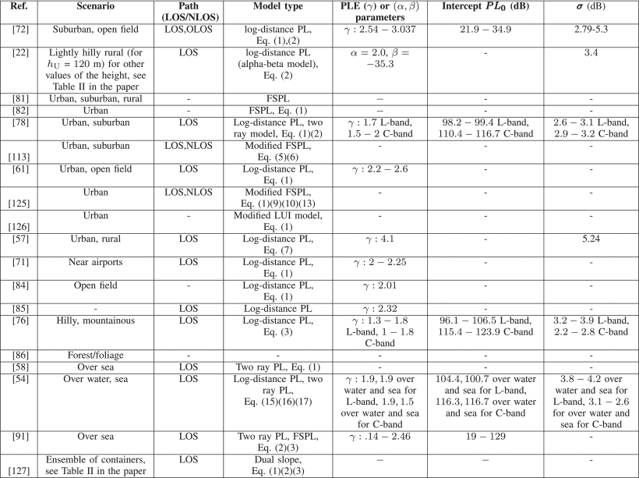
Modeling Options
Survey Paper identifies several approaches to modeling Large Scale fading effects: when LOS path between UAV Rx & emitter Tx gets obstructed by an object that is large relative to the wavelength
FSPL log-distance: Uses FSPL with an additional random variable for shadowing
Floating Intercept (FI) PL: uses a slope & intercept with a random variable for shadowing
At short distances, model provides underestimated PL
At larger distances, model provides overestimated PL
Dual Slope PL: for areas where the channel characteristics do not drastically change, especially with NLOS paths & complex geometries. Uses a distance threshold.
Ref 127 & Ref 131
Log-Distance PL – uses 1, but with additional NLOS shadowing due to buildings (ref 125)
Modified FSPL: takes into account 3D motion of UAVs, especially with elevation effects (ref 114 & 133 uses LOS & NLOS)
Two-ray PL: Log-normal random variable is either UAV shadowing OR MPCs from terrestrial scatterers (choose the appropriate RV based on environment)
Log-Distance FI: log-distance FI models for the PLE and shadowing
LOS/NLOS Mixture: Average PL over probabilities of LOS & NLOS. Prob. LOS takes into account avg. Urban geometry. Does not include variability – which is needed for multipath.
Overall
Two-Ray is better for open field, rural, and over sea
3-ray or 4-ray is better for large number of scatterers whose heights are comparable to UAV height (ref 78), log-distance PL model is used best for urban environments (#4 above)
Table V: for complex geometrical environments with large number of scatterers in a LOS path between the GS and the UAV, a DS PL (#3) may be best
Per ref 108 (Link) : two categories of received power:
(Rays 1 & 2) Persistent components arising from LOS and ground reflection paths
(Rays 3+) Others from the surrounding scatterers.
Other References
Ref 113; Ref 57 is only for 2 GHz; Ref 61 does not account for MP; Ref 81 does not provide a model; Ref 82;
Ref 113; Starting point!!!
Notes:
Emergency transponder beacon
GPS constraints
MINIMAL MEASUREMENTS & COMPUTATIONS
Time-based because phase coherence is challenging among array receivers
Pros: Small UASs allows for more challenging/dynamic mission environments that large aircraft cannot penetrate
Cons: carrying capacity (power, payloads); coupling the RF apertures

Slide 44
Time Delay Determination
Determine RF propagation path loss for a given Emitter/Receiver pair for the following conditions:
Free space (using Free Space Path Loss model)
LoS (using ITU-R 1411)
NLoS (using ITU-R 1411)
Rain Attenuation (using Crane model)
Determine probability that the pair is in a building or ground scattering condition (using Pang model)
Multiply probability for each condition against path loss, and sum all results for total path loss
Convert resultant path loss to "Time of Flight" using Free Space model

Slide 45
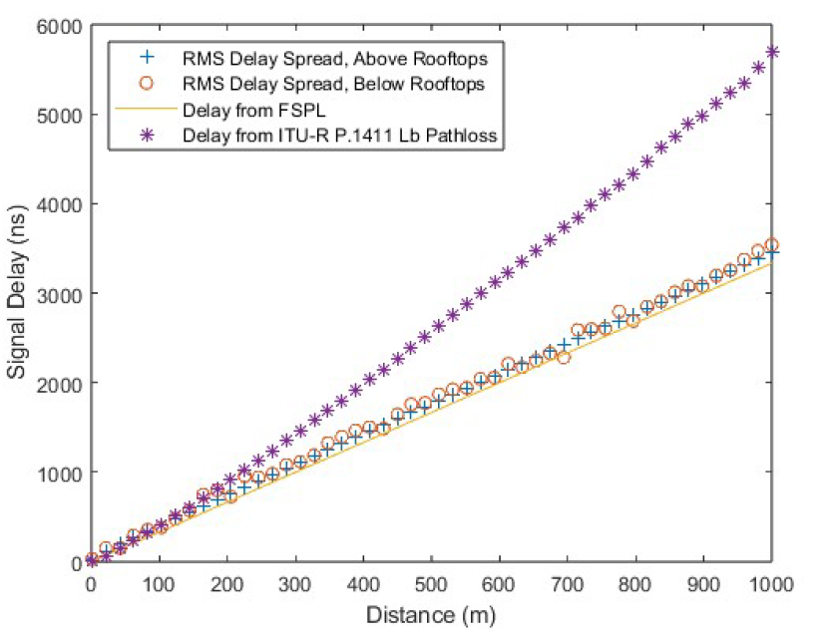
RMS Delay Spread

